Slide 1
First Order Logic

Slide 2
Propositional Logic
Syntax
Semantics
Interpretation

Slide 3
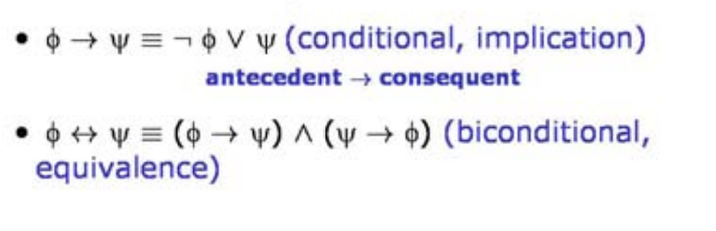
Rules
Interpretation for the main logical operators
(Truth Tables)

Slide 4
Validity and Satisfyability
A sentence is valid iff its truth value is True in all interpretations
A sentence is satisfiable iff its truth value is T in at least one interpretation
A sentence is unsatisfiable iff its truth value is False in all interpretations

Slide 5
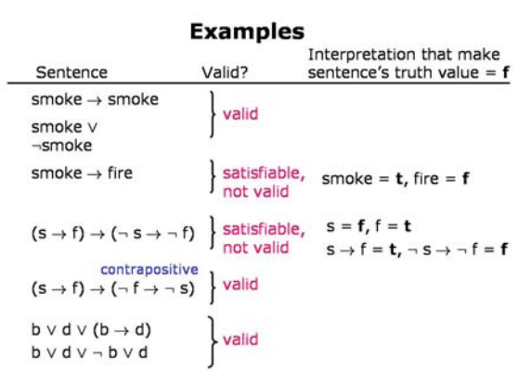

Slide 6
The Satisfiability Poblem
Given a sentence S, find an interpretation that satisfies it (i.e., makes it true).
Methods:
Brute force (i.e., ty all)
Heuristic search
Constraints propagation
Stochastic search

Slide 7
Satisfiability Problems
Scheduling nurses to work in a hospital
P=“Madalitso is working on Tuesday at 2”
Constraints on the schedule are represented as expressions over variables
Bugs in a program
Air Traffic Controll
P = all propositions describing how the air traffic control works
C=“there are two planes on the same runway at the same time.”

Slide 8
Entailment
A knowledge base (KB) entails a sentence S iff every interpretation that makes KB true also makes S true
KB = propositions (facts) and rules
How to compute entailment?

Slide 9
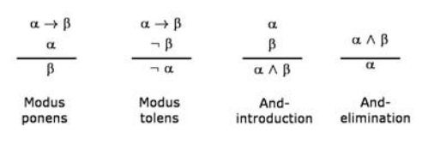
Proofs
Proof = sequence of rules

Slide 10
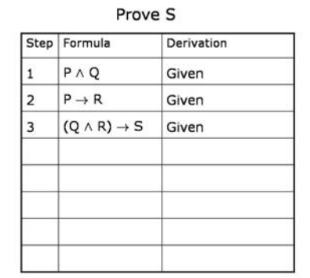
Example

Slide 11
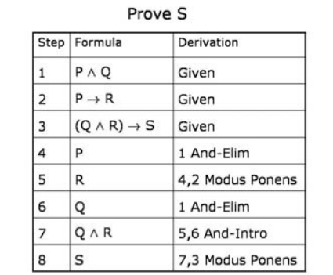
Solution

Slide 12
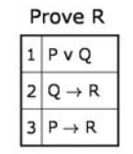
Theorem Provers
Use many inference rules => hence there are lots of possibilities or branches
It usually needs to do “proof by case”
Notes:
Another big problem is the need to do "proof by cases". What if you wanted to prove R from (P or Q),
(Q implies R), and (P implies R)? You have to do it by first assuming that P is true and proving R, then
assuming Q is true and proving R. And then finally applying a rule that allows you to conclude that R
follows no matter what. This kind of proof by cases introduces another large amount of branching in
the space.

Slide 13
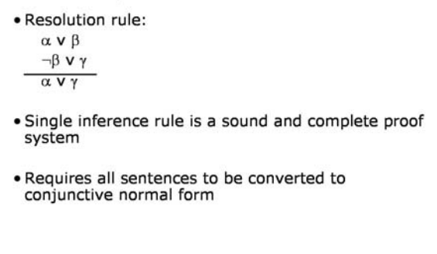
Propositional Resolution

Slide 14
First-Order Logic
“When you sterilize a jar, all the bacteria are dead”
Everybody loves AI.
Everybody has a father and a mother.
Whoever has a father has a mother.

Slide 15
Entailment in FOL
A knowledge base entails a sentence iff the sentence holds in every interpretation in which the knowledge base holds.

